Slide 1
Penta Intelligence | Group 18
IFN736 - Industry Project (Phase 2)
ReadAlert
An Integrated Reading Management Prototype

Slide 2
Penta Intelligence | Group 18
Meet the Team
Julia lezzi
Sude Karadeniz
PROJECT MANAGEMENT · BOOK CATALOGUE · FRONTEND INTEGRATION
TEAM LEAD · AUTHOR CATALOGUE · BACKEND INTEGRATION
Coordinating project delivery, reviewing team contributions, book management functionality and frontend integration.
Leading technical development, reviewing team contributions, resolving integration issues and coordinating backend implementation.
Ghazal Abdolah Zadeh Javazm
Amisha Patel
READING RECORD · FRONTEND DESIGN
READER PROFILE · DOCUMENTATION
Developing reading record functionality and consistent styling across modules.
Developing reader profile functionality and supporting project documentation.
Saarah Fariheen Sayeed
BOOK LOOKUP / SCAN
Making book discovery and tracking more convenient.

Slide 3


Project Overview
01
About ReadAlert
ReadAlert is a reading management Module developed as a part of the HuddleUp platform, in collaboration with our industry partner, Wayne Wood from the Cyber Security Centre.
Purpose
Project Outcome
Manage readers, books, authors and individual reading activity within a connected application.
A ReadAlert proof-of-concept (POC) comprising five microservice modules, with frontend interfaces, backend APIs and SQL Server database integration, developed for integration with the Huddle Up platform.

Slide 4


Project Objectives and Client Requirements
02
Project Objectives
Client Requirements
  Develop a ReadAlert Proof of Concept (POC)
  Manage reader profiles, authors, books and reading records.
  Support book lookup with scan/log functionality.
  Establish a foundation for Huddle Up integration.
Delivery condition: Prototype / Proof of Concept.
  Deliver Five Integrated ReadAlert Functional Modules
  Develop shared HTML, CSS and JavaScript frontend interfaces.
  Integrate ASP.NET Core API endpoints with SQL Server stored procedures.
  Implement JWT-based authentication and tenant/member context handling.

Slide 5
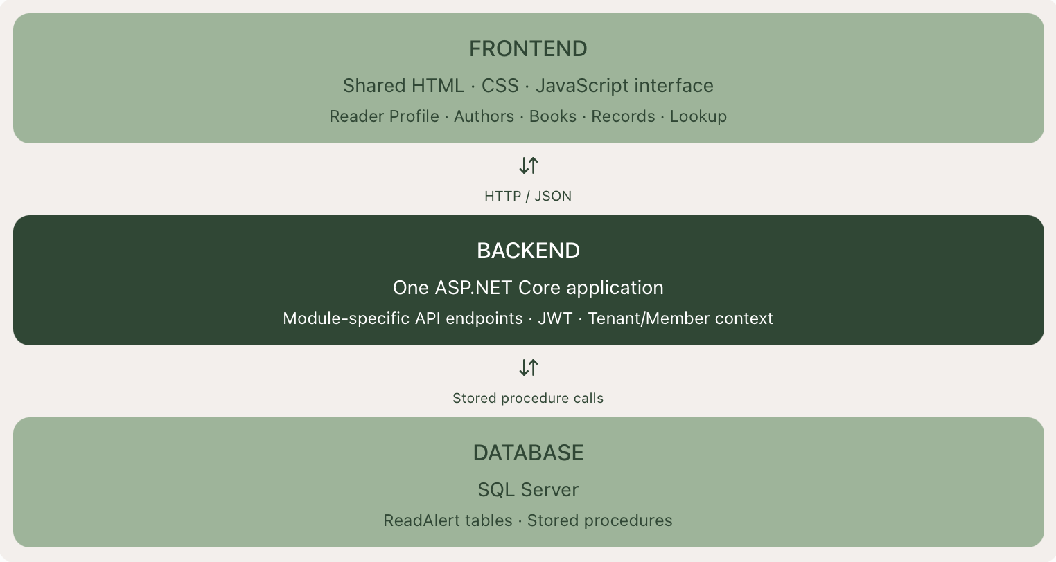
03
Technical Design
ReadAlert System Architecture
Three-layer architecture supporting five ReadAlert functional modules.

Slide 6
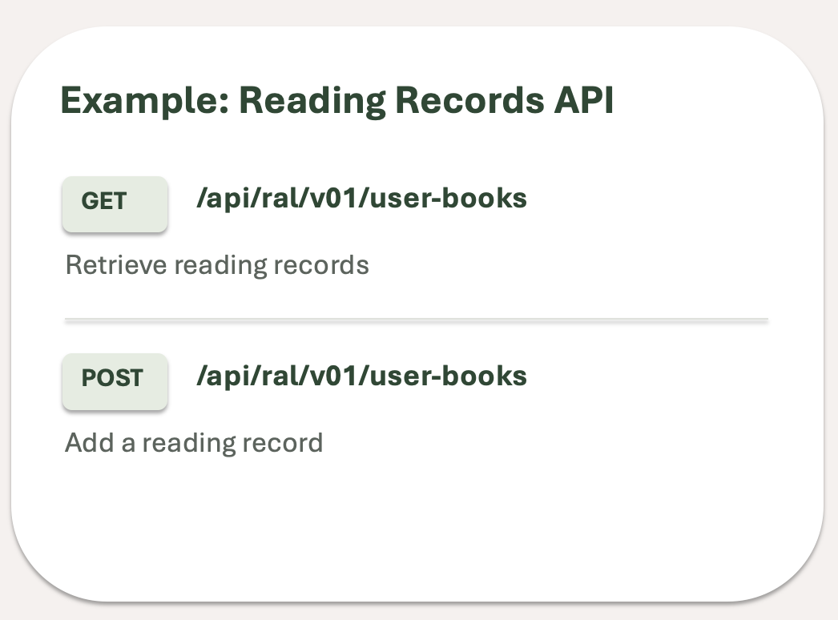
Technical Implementation
04
Backend Integration & API Design
Backend Implementation
  Consolidated ASP.NET Core backend
  Module-specific GET, POST, PUT and DELETE endpoints.
  SQL Server operations through stored procedures.
  JWT validation and tenant/member context handling.

Slide 7
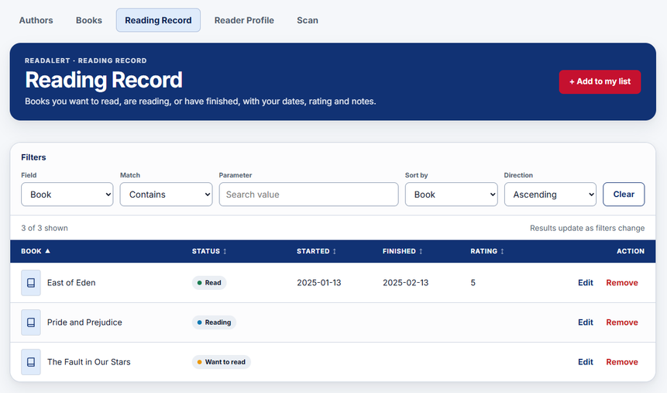
Shared Frontend Design
05
One page, five modules, one look
  Tabs for Authors, Books, Reading Record, Reader Profile and Scan
  Move between modules without leaving the page
  readalert-theme.css holds the colours, fonts and spacing
  Change the look in one place

Slide 8

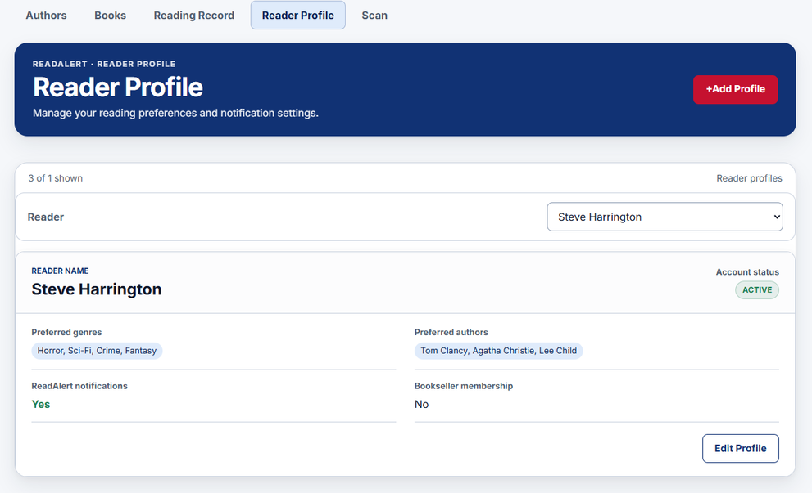
06
Core Module Implementation
Reader Profile Management
Frontend
Reader Profile interface developed for viewing and managing reader details.
Backend Integration
Designed to communicate with ReadAlert's ASP.NET Core API.
Data Management
Uses the project's SQL Server and stored procedure architecture.
Module Functionality
Reader Profile interface developed for viewing and managing reader details
Reader Identity
Organizes profile information around individual members.
Profile Data Flow
Connects the interface with the API and database.
Multi-Tenant Context
Uses Tenant ID and Member ID for profile identification.
Reader Profile → ReadAlert API → SQL Server

Slide 9
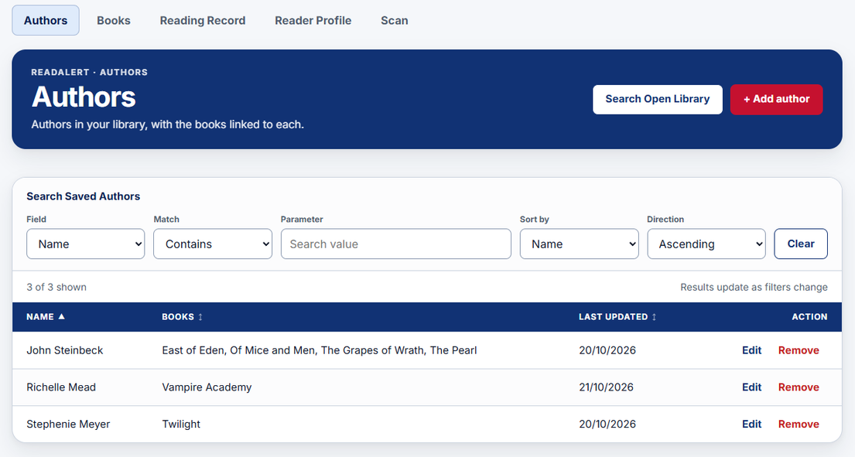
Core Module Implementation
07
Author Catalogue
Module Functionality
Provides a central catalogue for organising book information and associated authors.
Purpose
Search, view and manage author information.
Implementation
Author-related API endpoints and CRUD operations.
Integration
Open Library author lookup and SQL Server stored procedures.
The Author catalogue supports external and internal Author searches
Results can be filtered by ascending and descending order.

Slide 10
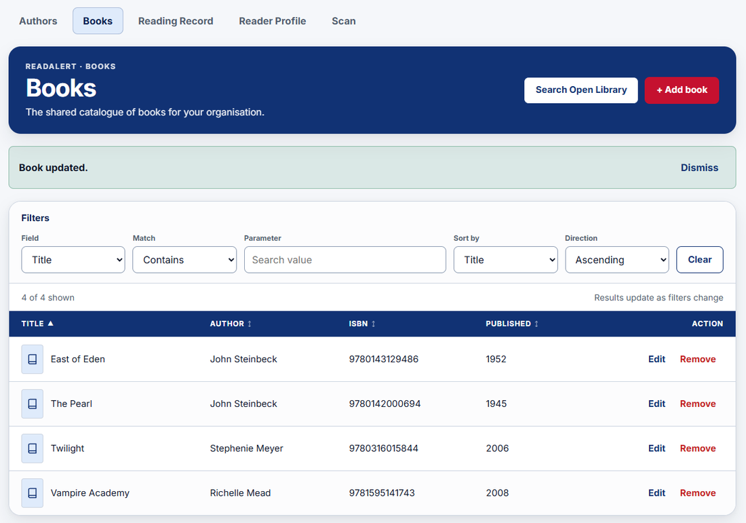
Core Module Implementation
08
Book Catalogue
Module Functionality
Provides a central catalogue for organising book information and associated authors.
Book Management
Search, view, add and edit catalogue records.
Linked Authors
Manage associations between books and author records.
External Lookup
Retrieves book details using ISBN lookup through Open Library, reducing manual data entry.
Book Catalogue interface displaying book records, linked authors
and management options.

Slide 11
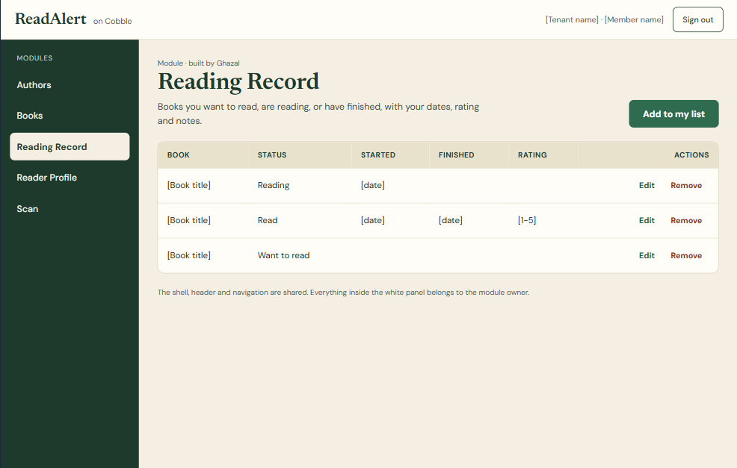
Reading Records
09
What it does
  A personal reading list for each member
  Track books you want to read, are reading, or have finished
  Add dates, a rating, a review and a private note
How it works
  Four endpoints: GET, POST, PUT and DELETE
  One stored procedure: ral_UserBooks_CRUD_JSON
  Tenant ID and Member ID come only from the JWT
Keeps data safe
  Each action needs its own permission
  One entry per book, and the book must exist in the catalogue
  Soft delete keeps the history

Slide 12
Core Module Implementation
10
Book Lookup / Scan Provides a central catalogue for organising book information and associated authors.
What it does
How it works
Search & Discover
Search the catalogue by title, author, or ISBN — results returned with match count and full book details.
Scan by ISBN-13
Scan a physical book barcode to instantly look it up — no manual title entry required.
Automatic Audit Logging
Every search & scan is logged: type, search text, result status (MATCHED MULTIPLE_MATCHES NOT_MATCHED).
Reading List Management
Add, view, update and remove books from a personal reading list - status, rating, review and finished date tracked per member.
Endpoints
Six routes: POST · GET · PUT · DELETE
/books/search /books/scan /user-books
Stored Procedures
Two dedicated lookup SPs
ral_SearchBooks_JSON — Title / Author / ISBN / Any
ral_ScanBook_JSON — delegates via ISBN_SCAN
JWT Validation
Inline — no ASP.NET middleware
JsonWebTokenHandler.ValidateTokenAsync()
tenant_id + member_id from token claims only — never from request body
Tenant Isolation
SESSION_CONTEXT set before every SP call
Database enforces isolation independently — no application-side WHERE clause required.

Slide 13
Technical Design
10
Book Lookup / Scan
Request Flow
Architecture Layers
Widget sends request
User types a search or enters ISBN-13. Frontend calls POST /books/search or /books/scan with Bearer token.
Inline JWT validation
API validates token via JsonWebTokenHandler. Extracts tenant_id and member_id. Returns 401 immediately if invalid.
SESSION_CONTEXT set
TenantID and MemberID written to SQL Server SESSION_CONTEXT before any DB call. Database enforces isolation independently.
Stored procedure executes
ral_SearchBooks_JSON or ral_ScanBook_JSON runs. Results returned as JSON. Lookup auto-logged to ral_BookLookupLog.
Response returned to widget
JSON payload: BookLookupLogID · SearchType · MatchCount · Books[ ]. Frontend renders results in Search Results table.
Frontend
Standalone widget — index.html + app.js
Token via Get Token button → POST /standalone/context
All calls attach Authorization: Bearer <token>
Backend — ASP.NET Core Minimal API
Single Program.cs — no middleware classes, no controllers
Direct SQL via SqlConnection + SqlCommand
SP pattern: @Payload in → @Result OUTPUT
Database — SQL Server (Cobbled_NoRLS)
Schema: ral · Tables: ral_Books · ral_Authors · ral_BookAuthors · ral_UserBooks · ral_BookLookupLog
All logic in stored procedures — no direct table access from API

Slide 14
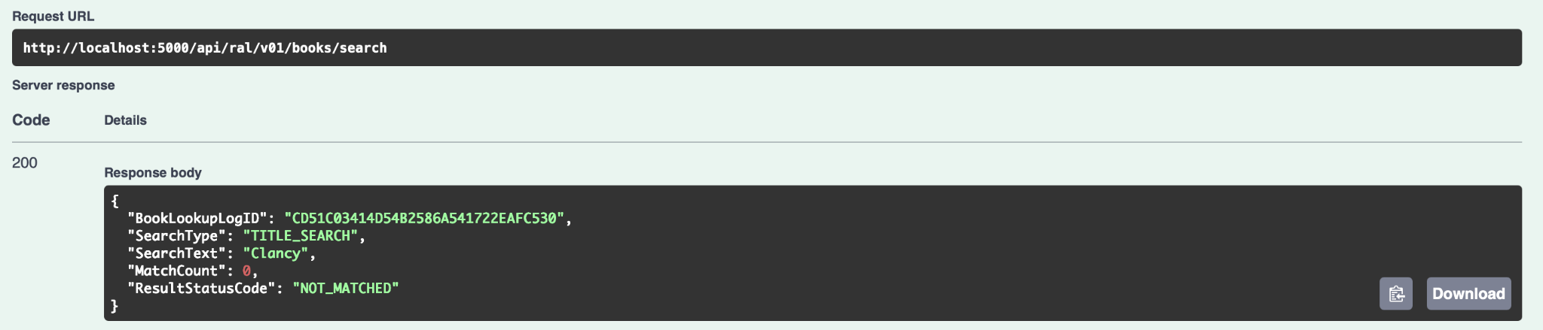
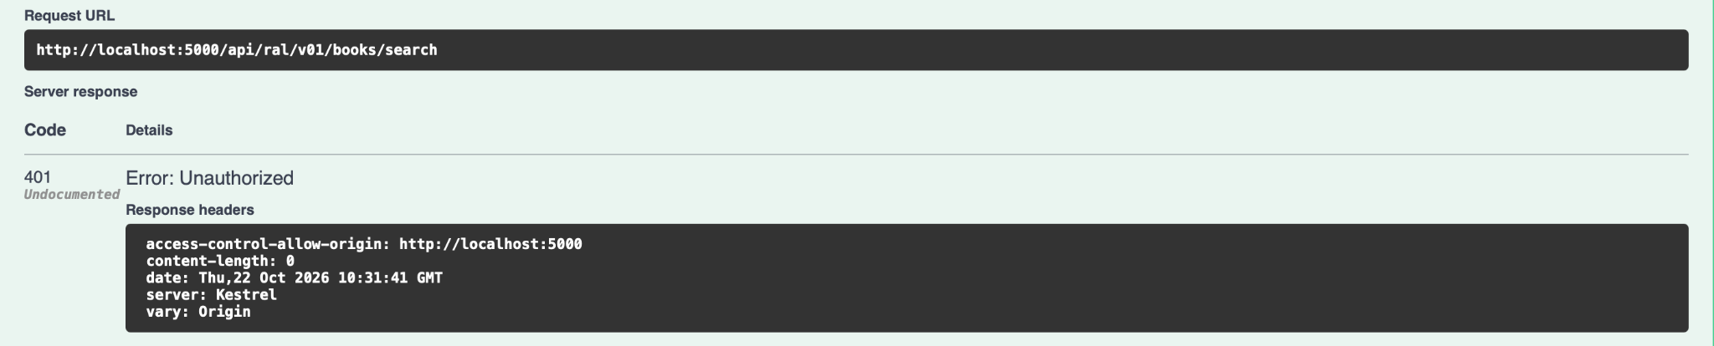
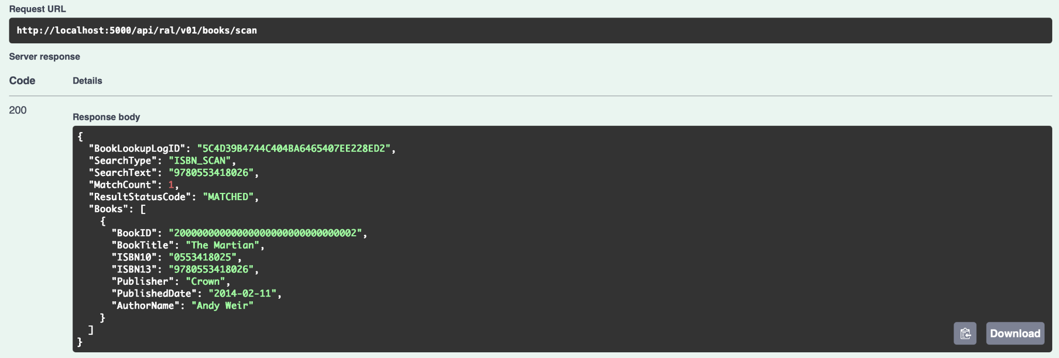
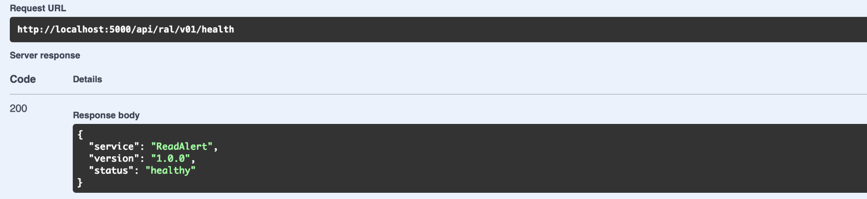
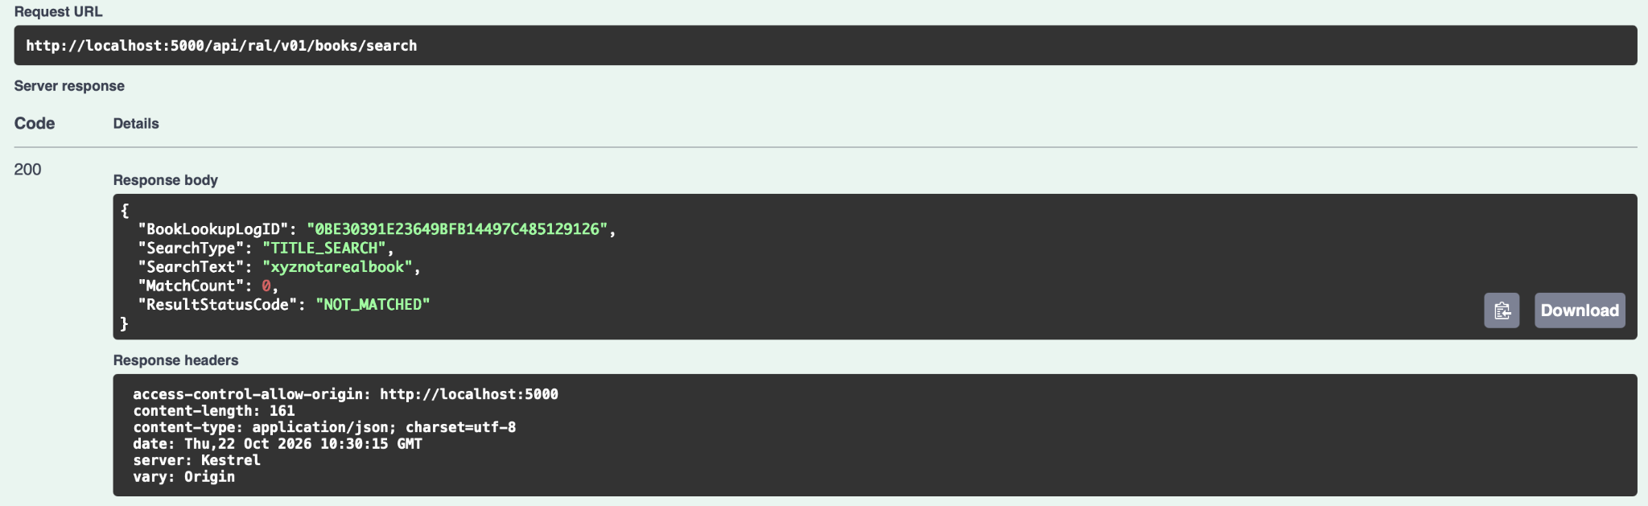
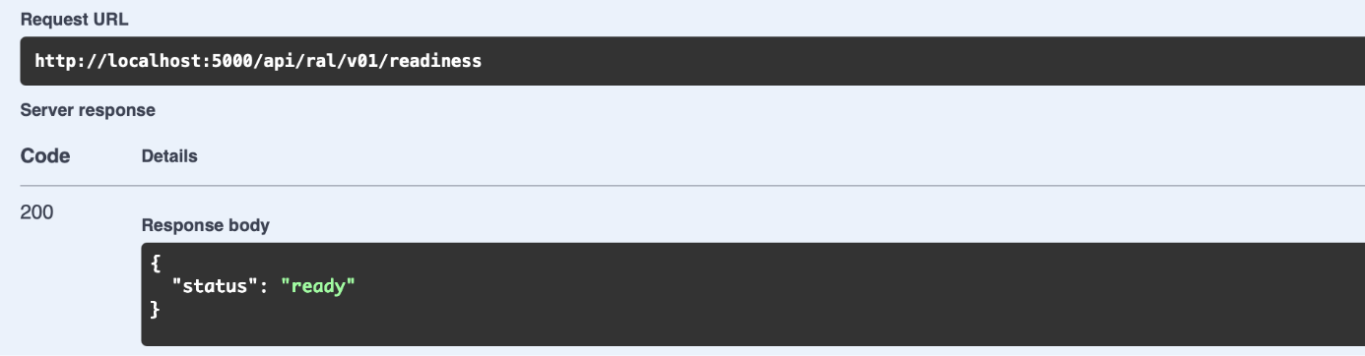
System Validation
10
Book Lookup / Scan
Functional Test
Security Test
Title Search — matched result
No Authorization header
ISBN-13 Scan — exact match
Health check — unauthenticated
Readiness check — DB + SP verified
Search — no match

Slide 15
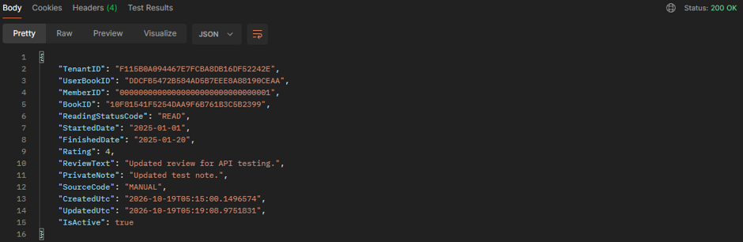
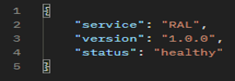
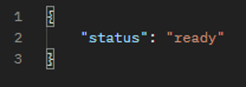
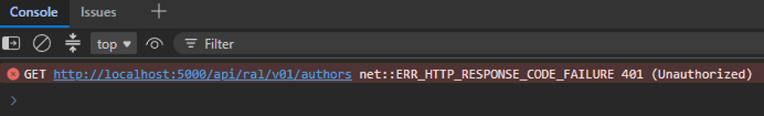
System Validation
12
Testing & Implementation Status
The endpoint successfully responds and returns the health status and readiness status.
The API accepts a valid UserBookID and a JSON response containing the updated reading details. It updates the existing user book record in the database.
The API returns error 401 when no valid JWT is provided.

Slide 16
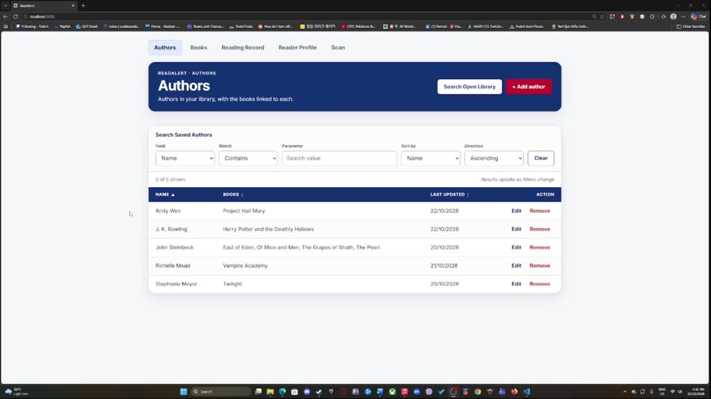
Live System Walkthrough
13
ReadAlert System Demonstration

Slide 17
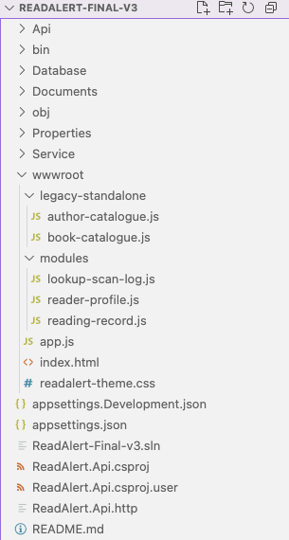
Technical Challenges
14
Project scope adjustments
Revised scope received at the end of Week 5
Technical learning and development
Diverse academic backgrounds and experience levels
Frontend integration
Aligning independently developed modules and file structures
Feedback and coordination
Navigating technical clarifications and dependencies
Opportunities for further development
Additional integration testing, refinement and security validation

Slide 18
Technical limitations
15
  Huddle Up Platform Integration
Full integration with the existing Huddle Up environment has not been completed or verified.
  Deployment Architecture
  End-to-End Testing
  Production Readiness
ReadAlert currently operates as a prototype rather than a set of independently deployable
microservices.
Comprehensive integration, performance and security testing remains outstanding.
Further validation, configuration and operational hardening are required before production deployment.

Slide 19
Project Outcomes and Handover
16
Delivered Prototype
  Five integrated functional modules
  Shared frontend and consolidated backend
  SQL Server and stored procedure integration
  Source code and supporting documentation
Future Development
  Independently deployable microservices
  Complete Huddle Up host integration
  Further production hardening and validation
Documentation Package
  Setup & Running Guide
Prerequisites, configuration and execution
  Technical Handover Guide
Architecture, API routes and dependencies
  Testing & Completion Summary
Validation results and known limitations

Slide 20
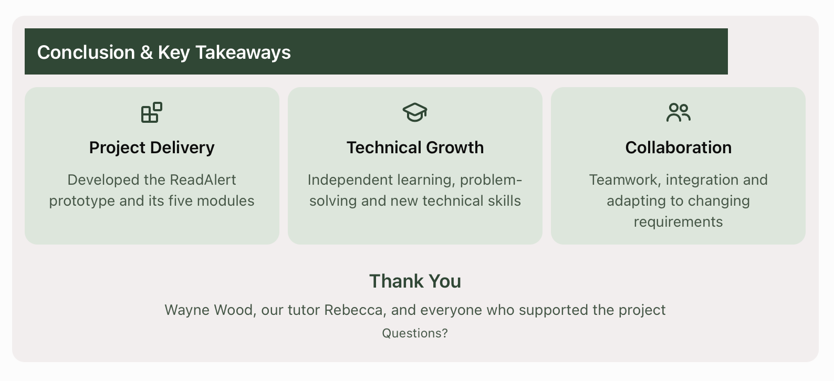
Conclusion
17

Slide 21
Team 18
Thank You

